Slide 1

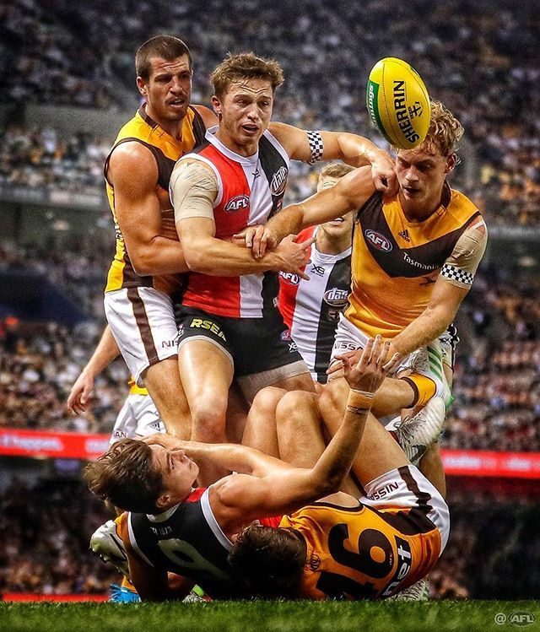
AFL Fantasy Football Analysis & Prediction
Photo credit: Michael Wilson (link)
Mark Richards

Slide 2
First off… What is Fantasy Football?
Players are awarded points for certain acts or stats during a match
1 kick ≈ 3 points
1 handball ≈ 1 point
1 goal ≈ 8 points

Slide 3
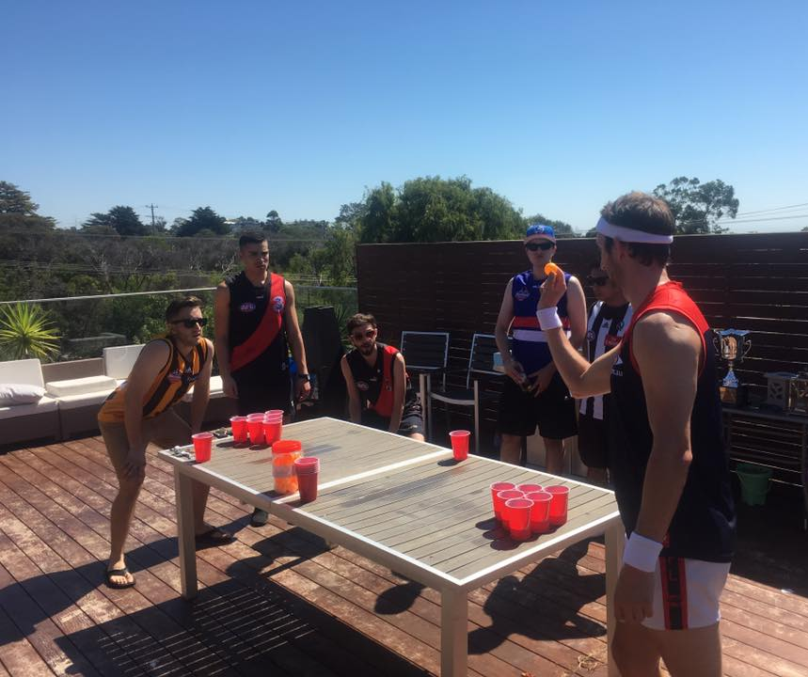
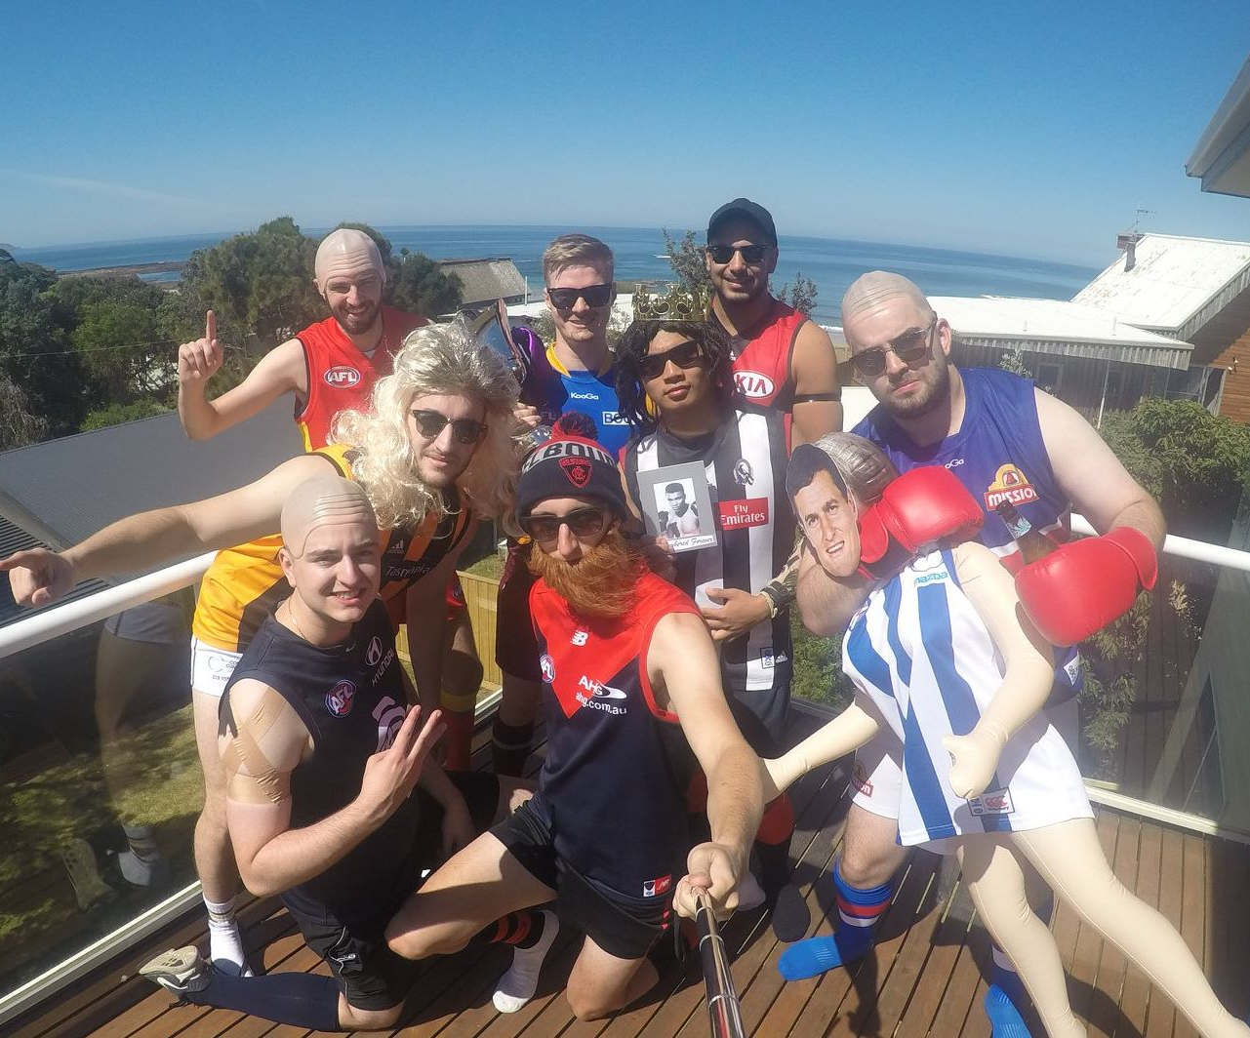
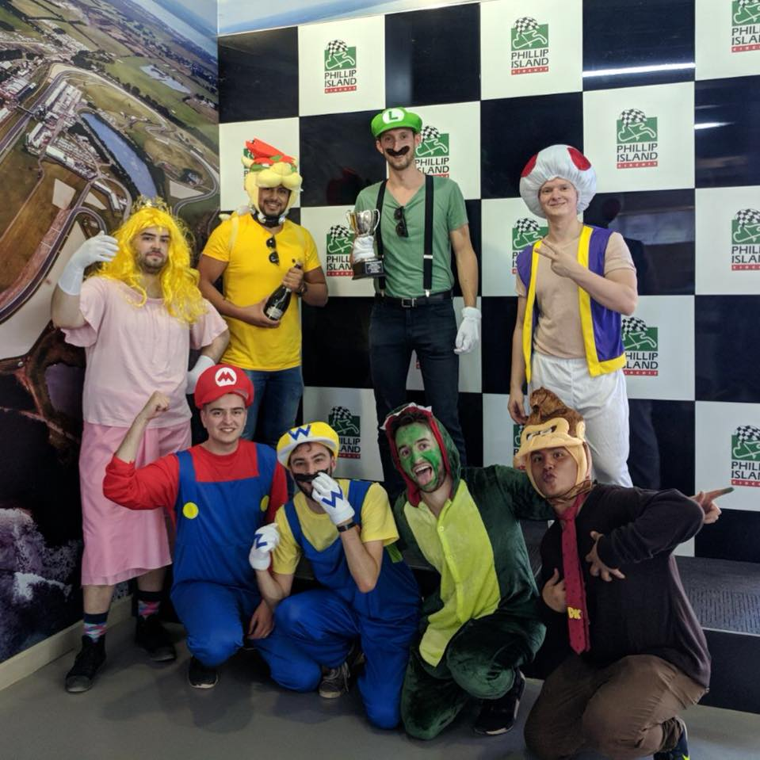
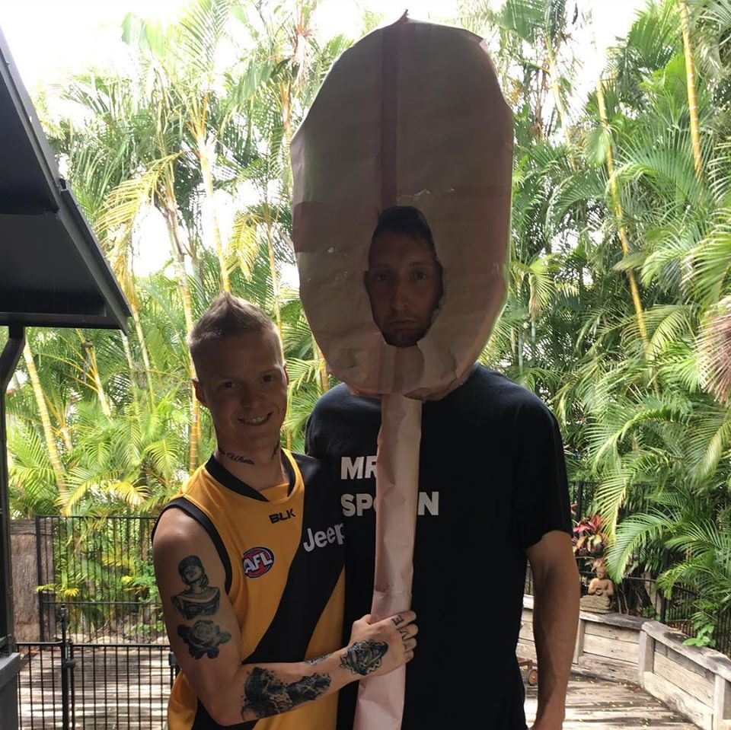
What is Fantasy Football?
YOU become the coach
Each week you are responsible for choosing a team of players
Highest points wins!
A.K.A Sport for nerds (Dungeons and Dragons for Jocks)
This normally results in a very competitive bunch of people
Yes that’s me as a wooden spoon after I finished last the previous year…

Slide 4
What insights can be gathered from 10 years of AFL statistics and fantasy scores?
Fantasy…
What is the best fantasy scoring method? Which is the strongest indication that a team will win?
Predict future Fantasy scores for players

